Slide 1

Food ordering system
submitted by:
Vaibhav Kumar
181500774
Shivam Rajput
181500669
Supervised By: - Dr. Anand prakash gupta (Technical trainer) Department of Computer Engineering & Applications
GLA University
Mathura-281406,INDIA
2020

Slide 2
Abstract
In this document the requirements specification for an online food ordering system designed primarily for use in the food delivery industry.
My system will allow restaurants to quickly and easily manage an online menu which customers can browse and use to place orders with just a few clicks. The system then relays these orders to restaurant employees through an easy to navigate graphical interface for efficient processing.

Slide 3
Introduction
In today’s age of fast food and take-out, many restaurants have chosen to focus on quick preparation and speedy delivery of orders rather than offering a rich dining experience.
Until very recently, all of these delivery orders were placed over the phone, but there are many disadvantages to this system, including the inconvenience of the customer needing to have a physical copy of the menu, lack of a visual confirmation that the order was placed correctly, and the necessity for the restaurant to have an employee answering the phone and taking orders.

Slide 4
What to do
provide a display that will allow the customer to choose menu items and make corrections.
update this display with changes to the order.  provide a running total cost and calorie/fat count.
At order finalization, we will request identification information from the customer.
offer a static map of our surrounding area so that customers unfamiliar with our location can find us.

Slide 5
Technology used - In this project we use MERN technology.
Language used
M - Mongo db
E - Express js
R - React js
N - Node js

Slide 6
Language used
Mongo db - MongoDB is an open-source document database and leading NoSQL database. MongoDB is written in C++. This tutorial will give you great understanding on MongoDB concepts needed to create and deploy a highly scalable and performance-oriented database.
React js - React is a JavaScript library for building user interfaces.React is used to build single page applications.React allows us to create reusable UI components.

Slide 7
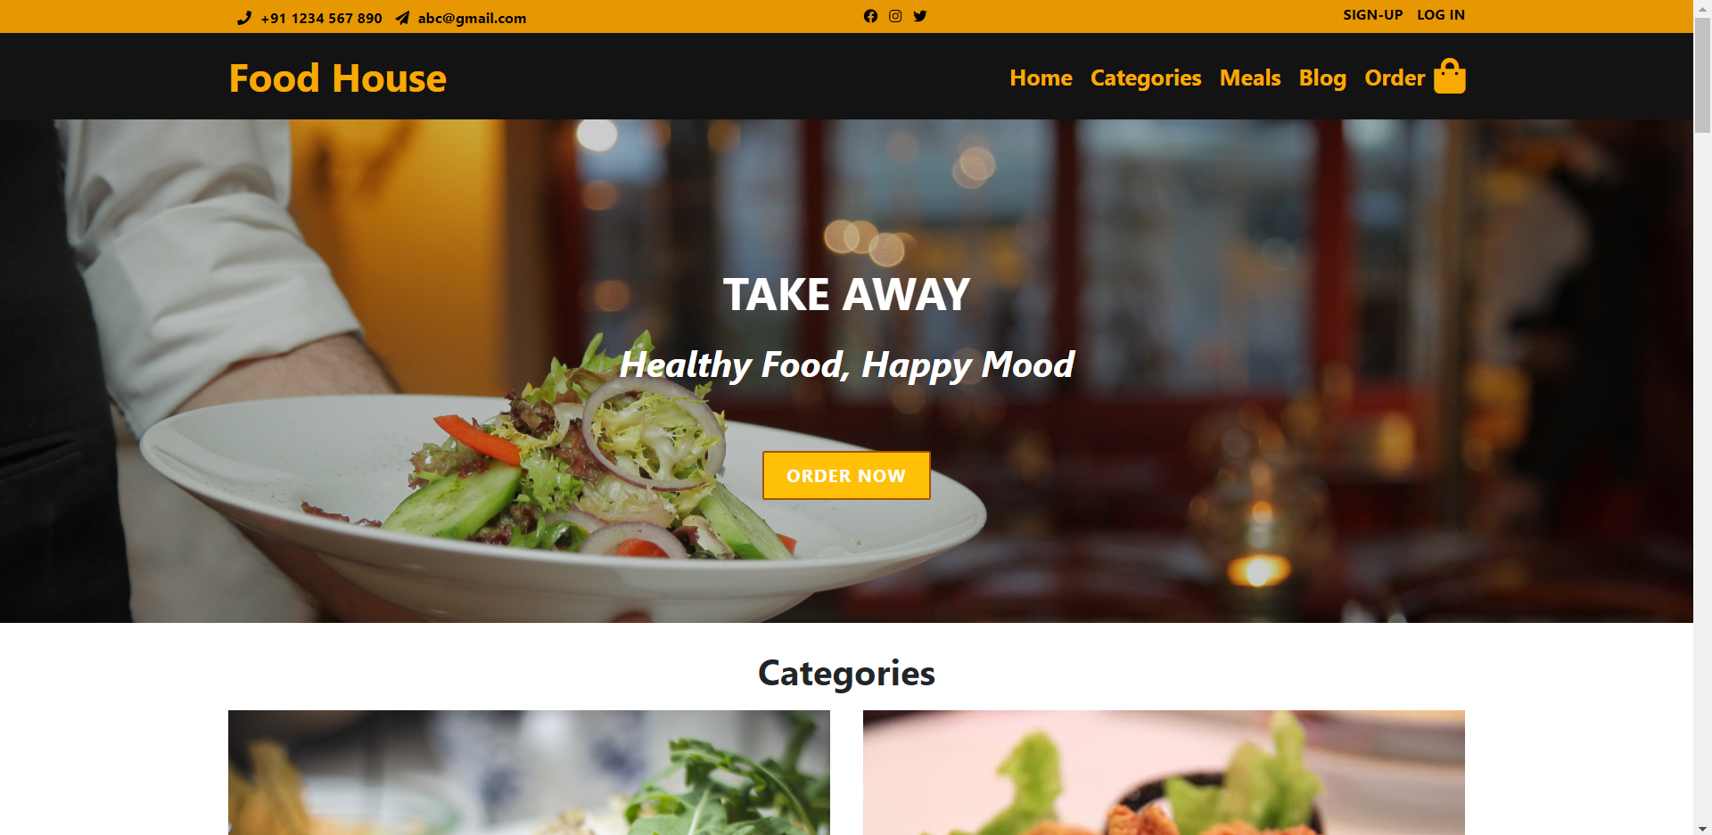
Screen-shots

Slide 8
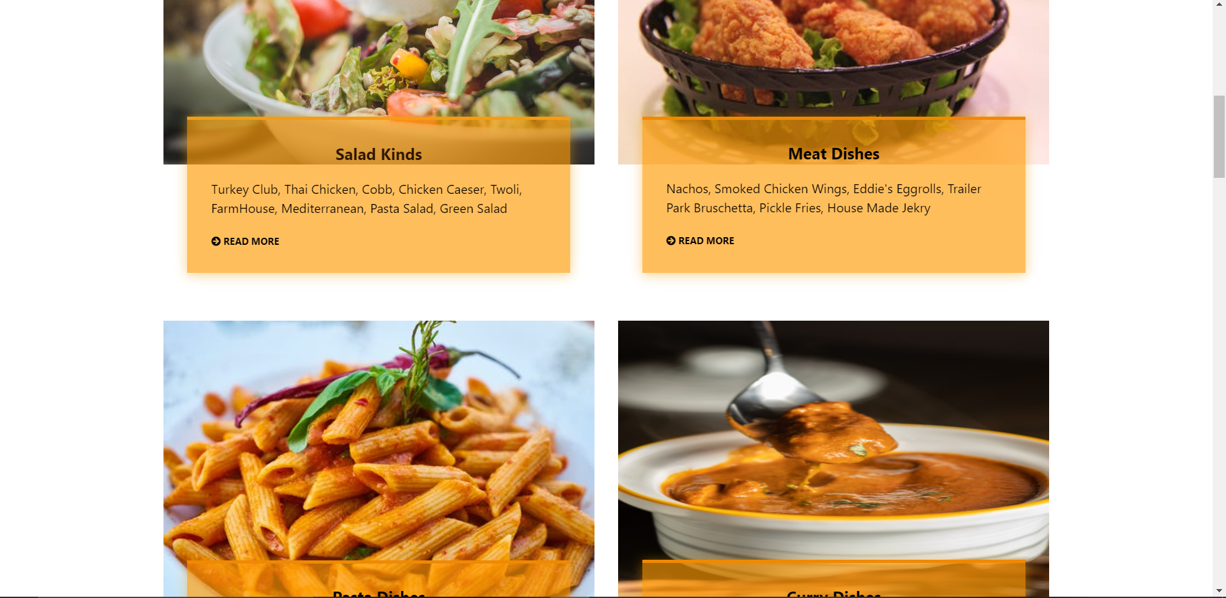
Screen-shots

Slide 9
Tool recuired
Hardware requirements ->
System having at least 4 GB of RAM.
Laptop with i3 5th Generation processor
Software Requirements ->
Visual studio code
OS ( Windows or Linux)
Languages and framework ->
HTML, CSS, Java-Script
React-js, Mongodb, Node-js

Slide 10
References
https://www.w3schools.com/
https://reactjs.org/
YouTube.com

Slide 11
THANK YOU

